Slide 1
Design and Implementation of an Expert Recommendation System for Making Design Decisions
Kevin Koch, Advisor: M.Sc. Manoj Mahabaleshwar, Garching, 28.05.2018

Slide 2
Agenda
1
Introduction
2
Research Questions
3
Approach
4
Empirical Research
5
Prototype
6
Evaluation
7
Conclusion
8
Sources

Slide 3
1. Introduction
Example Scenario
Apache Spark
Issues captured since early 2014
Versions from 0.9.0 to 2.1.0
# contributors - 1,146
# issues - 21,660
User
Create new issue
(incl. design task)
We want to use Spark SQL in our project, but we found that the Spark SQL performance is not very well as we expected.
SPARK-7393
?
Who should be assigned?
Software Architects
Software Developers
Notes:
Short introduction
Example project Open Source now – however not focused on FOSS
(comparison to projects at Siemens where many people from different are involved – large scale projects)
Many contributers, many issues
Users create a new issue/feature request which is identified by a design task (Manoj recent work already make this possible)
Solved by developers or architects…
These developers can be world wide assigned…
Core Question is – who should be assigned???
I want to answer this in my research

Slide 4
1. Introduction
Example Scenario
Apache Spark
Issues captured since early 2014
Versions from 0.9.0 to 2.1.0
# contributors - 1,146
# issues - 21,660
User
Create new issue
(incl. design task)
We want to use Spark SQL in our project, but we found that the Spark SQL performance is not very well as we expected.
SPARK-7393
Analysis of
existing issues
!
!
Assignment Recommendation
Expertise Identification
Additional factors as newcomers, workload of experts,…
Architectural Elements
Software Quality Attributes
…
Software Architects
Software Developers
!
Expertise Profiles / Roles
Notes:
Further parts include to identify expertise – what can an expert trustworthy solve… and the overall process in solving.
Especially, if certain roles with more responsibilities exists

Slide 5
2. Research Questions
How to quantify/measure the expertise of software architects and developers in the context of design decision-making process?
?
What are the separate roles taken during the decision-making process to address design decisions?
?
How to automatically identify experts to address design decisions and allocate roles to the recommended experts?
?

Slide 6





3. Approach
Systematic Literature
Review
Systematic Literature
Review
Case Study
with 5 professionals
Case Study
with 5 professionals
Meta-analysis for
Requirements
Meta-analysis for
requirements
Prototype
UI and 4 algorithms
Prototype
UI and 4 algorithms
Evaluation
Evaluation
Notes:
Overview in short:
1. Empirical insights by the means of a systematic literature review and a case study with professionals
2. These results in a meta analysis translated into requirements - Requirements represent needs for a expert recommendation system to solve design decisions
3. build a prototype based on these requirements – consists of UI and 4 algorithms to provide insights into a feasible solution
4. evaluate the prototype – main focus on algorithm evaluation

Slide 7
4. Empirical Research
Systematic Literature Review
Focus:
Behavior of architects and designers
Search in
3 databases
and
4 conferences
4 Stage Study Selection Process
Summarization of studies
Results:
1.840
Selected studies:
39
4 major categories
[1] Keele, S. (2007). Guidelines for performing systematic literature reviews in software engineering.
Notes:
Focus: Behavior – all empirical research that covers decision making and behavior of designers and architects in companies
Databases: Science direct, ACM (association for computing machinery) and IEEE Xplore
Conferences: DESRIST, ICSA, ECSA, WICSA
Search terms “Software architecture” OR “Software design” AND role OR expert* OR “decision making”
Used help of Litsonar
-> 1840 results – of course selection necessary
4 steps procedure (download all, read title, read abstract and finally read complete paper)
Last step summary of studies
4 larger categories: Architects Desginers and their Role in Organizations, Expertise Skills inspected in Detail, Infleunce Factors in Decision-Making, Decision Making
More subtopics, e.g. Expertise Skills – General Design process, usage of whiteboards and sketches, prototyping,…
e.g. roles: line approaches, agile or project

Slide 8
4. Empirical Research
Case Study
Focus:
Assignment procedures
Semi-structured interviews
with questionnaire
Transcription of interviews
Inductive Category Formation
Participants:
5
Pages:
74
For the 3 RQs
15 categories
[2] Runeson, P., & Höst, M. (2009). Guidelines for conducting and reporting case study research in software engineering.
[3] Mayring, P. (2014). Qualitative content analysis: theoretical foundation, basic procedures and software solution.
Notes:
In contrast to literature review, real focus on experience of professionals in assignment procedures
-> semi structured interviews with 5 participants of 2 companies
in average interviews 55 minutes – all recorded and transcripted
On the transcripts then inductive category formation ->
So, in three rounds (for each research question), the transcripts inspected for content targeting this research question
creation of categories to find content overlap between interviewees
In total 15 categories,
RQ1, e.g. Technology Knowledge, Domain knowledge, Topic Knowledge,… Seniority, Knowledge vaporization, Soft factors,…
RQ2: Development & team organization, role of architects, Seniority as a role, novices and lack of experience
RQ3: Architecture meetings, Assigment procedures, Problems,…

Slide 9
4. Empirical Research
Meta-analysis for Requirements
Primary Requirements
R1 | The system recommends suitable experts to design decisions
R2 | The system includes novices in its recommendations
R3 | The system balances a team‘s knowledge distribution with its recommendation
R4 | The system processes social compatibility of people in the recommendation process
R5 | The system involves an expert‘s available time in the recommendation process
R6 | If a design decision is created, an initial assignment to the backlog owner is mandatory
R7 | The system establishes the role of an accountable assignee
R8 | The system allows to assign a fixed group of people representing common structures in a company
R9 | Based on a design decision’s priority and complexity, the system proposes how many people to assign
R10 | The system aids in the prioritization and complexity measurement of a design decision
Notes:
All requirements…. Just read them?
RQ1 in a second more in detail
RQ2 + 3 do not recommend only the best fitting person
R4 + R5 Soft factors – how well can people work together and do they have actually time to solve a decision?
R6 + R7 two important roles – backlog owner as manager of issues and accountable person as issue owner
R8 + R9 Teams teams teams, design decisions are seldom solved by one person – depending on the complexity/priority
R10 Complexity and priority determine who to assign -> important to help

Slide 10












4. Empirical Research
R1: The system recommends suitable experts to design decisions
Knowledge Measurement
Abstract Knowledge (Topic or Domain)
Technical Knowledge
Knowledge gain & loss
Seniority / Experience
Time
Possible sources:
Most critical requirement
Notes:
Requirement 1 – recommend suitable experts more in detail – critical requirement for an expert recommender
Find the right expert for a problem!
What did the literature review and the case study find in means of this requirements
Actually 3 major findings
First in what can experts be good? Knowledge measurement can be performed more or less in two categories
- Bare technical knowledge, e.g. how good is a person with a specific technology… examples are programming languages but as well complex frameworks as spring or the play framework
Abstract knowledge gets a step further – combining these technical skills or even go beyond it – knowing about a topic, e.g. web development means to combine single technology knowledge to be e.g. a fullstack developer – or knowing about a specific domain, e.g. the finance sector
The second points answers how experts gain or loss their knowledge
- Seniority and/or experience express, the more often someone did handle a problem, the more esxpertise he has
Time… is a negative factor… the more distant in the memory an experience is, the less knowledge has this expert actually
And finally, I inspected possible sources where these information can be…
So – that is the empirical part… in the next step it was mandatory to design the system…

Slide 11
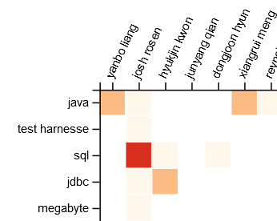
5. Prototype
Algorithms
Technical Knowledge
Concept-based
Extension:
Decreasing knowledge
Start
Issue j
Today
Abstract Knowledge
(Topic/Domain)
Latent Semantic Analysis (LSA)
Latent Dirichlet Allocation (LDA)
Cluster
(Word2Vec)
Fix the java8-tests profile and run those tests in Jenkins
Spark has some tests for compilation of Java 8 sources (using lambdas) guarded behind a {{java8-tests}} maven profile, but we currently do not build or run those tests. As a result, the tests no longer compile. We should fix these tests and set up automated CI so that they don't break again.
Notes:
Algorithms to identify expertise
Aligned with technical knowledge and abstract knowledge
Concept base; frequency count of architectural elements – so single technical skills
An extension with decreasing knowledge
Abstract knowledge: LSA, LDA and Cluster approach
LSA and LDA are two algorithms to identify in different ways polysemy and synonmy
LSA reduces a tf-idf matrix, LDA is a bag of word concept for topics and the cluster approach and word2vec builds a neuronal network to identify words with similar context and then cluster similar issues

Slide 12
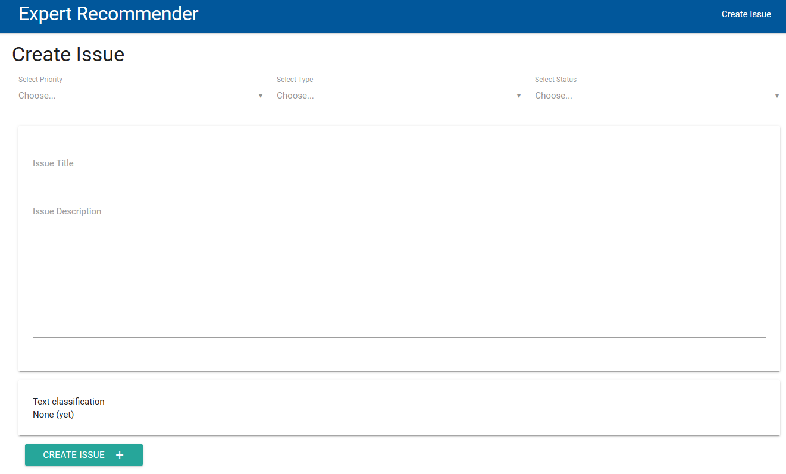
5. Prototype
Live Demo
Notes:
3 Steps then
create issue – receive indication of necessary expertise
then actually switch the role from issue creator to Product Owner (backlog owner) – assign Priority and type – get help… top experts, show skills
Then we can assign teams, experts and novices – recommendations – show teams, show experts, show ranking…
remove expert…
Switch algorithm – start LDA, then Concept, then KNN, LSA no and Vanish equal to Concept
Topic 1: clear assignment

Slide 13



6. Evaluation
Overview
Inspect recommender accuracy of algorithms
Find differences and characteristics of the algorithms
Goals
Datasets
Total issues: 22.279
Design decisions: 446
95 unique assignees for design decisions
Total issues: 12.906
Design decisions: 238
111 unique assignees for design decisions
Notes:
So…. In a last step, the algorithms were tested…
Find out how well they work and how they differ in their application
Data of two projects – apache Spark and Apache Hadoop
Design decisions, assignees, time span,…

Slide 14
6. Evaluation
Steps for each evaluation run
1
Sort all design decisions by resolution date ascending
2
Split data in training and test data
Training sizes range from 40% to 90 %
3
Only LSA, LDA and Cluster:
Set a parameter k for amount of topics or clusters
4
Use training data to build a model or/and create the expertise matrix
5
Predict on test design decisions accuracy by expert list sizes from 2 to 30
.
(A correct match of 50% at P@2 means that in half of the test data the original assignee was recommended in a list of two experts)
Notes:
Topic parameter (2-200) or cluster parameter k (2-30)
Means concept and decreasing knowledge each 6 runs
LSA and LDA 198 x 6 (1188)
Cluster 28 x 6 (148)

Slide 15

6. Evaluation
Apache Spark Project
LDA & LSA
Average results for k from 2 to 200
Cluster
Average results for k from 2 to 30
Notes:
You see here the results of the Apache Spark Project, for each algorithm its best results in a training size.
LSA, LDA and cluster are averaged results for all k values, Concept and Decrease are single values per run
Cluster drops a bit because larger cluster sizes do not work that well… smaller instead do
All other algorithms conceive comparable results
Training sizes between 40 – 60 %

Slide 16

6. Evaluation
Apache Spark Project
40% - 60% training dataset sizes lead to better results in lower recommendation list sizes
Larger training data leads to overfitting
Training Size
Concept-based
&
decreasing knowledge
yield similar correct matches
LDA
needs multiple runs to build a “good” model
LSA
relatively stable over most k values
Cluster
works only with smaller cluster sizes
Notes:
Findings in the Spark project
Best results are achieved with lower training sizes – because larger training sizes tend to overfit
in this case, it means that general concepts or topics and the amount of work experts did influence the final decision to much
Looking at the algorithms in detail, concept based and decreasing knowledge yield similar results – so no change in time
LSA – the parameter change of k has little influence, e.g. a k of 10 is good enough to provide promising results
LDA – needs multiple runs, as model is infinite – initial assignments of topics happens at random
similar to KNN
Cluster approach seems a bit less promising, however in contrast to other methods is expertise assignment more strict – just issues in the same cluster are compared
lower cluster sizes yield similar results

Slide 17
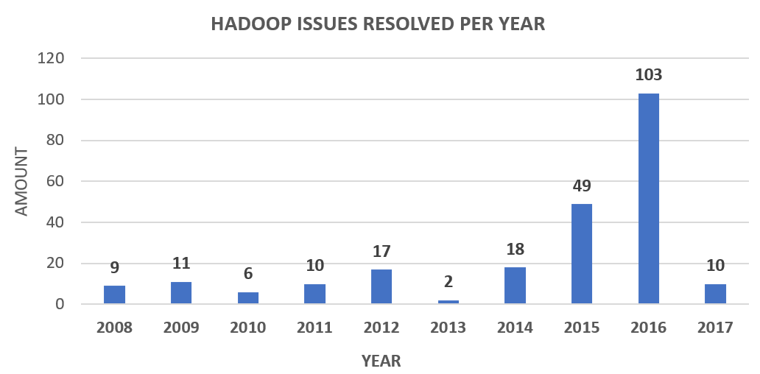
6. Evaluation
Apache Hadoop Project
Additional Facts:
2.1 DDs*/assignee
(vs. 4.7 in Spark)
60 % of assignees only solved 1 DDs
(vs. 47% in Spark)
24 % of assignees only solved 3 or more DDs
(vs. 39% in Spark)
75 unique assignees
for 122 design decisions
58 unique assignees
for 162 design decisions
Just 22 assignees are identical
*DD = design decision
Notes:
4.7 in spark

Slide 18
6. Evaluation
Apache Hadoop Project
LDA & LSA
Average results for k from 2 to 200
Cluster
Average results for k from 2 to 30
Notes:
Again same graph, but now for the Hadoop project
Training sizes for all algorithms 90 %
Cluster fails as previously said…
Decrease knowledge performs better (recognizes earlier than concept based) expertise
LSA and LDA in their average results work best…
But in the end looking at single k values, they achieve sometimes even better results as in the Spark project

Slide 19
6. Evaluation
Apache Hadoop Project
Best Results:
90% training size highest results over all training list sizes
!
only 2.1 design decisions/assignee, fewer design decisions & they are distributed over a long time span
Training Size
Concept-based
&
decreasing knowledge
Decreasing knowledge improves results
LDA
can achieve comparable results as in the Spark project
LSA
can achieve comparable results as in the Spark project
Cluster
too few design decisions are available to build meaningful clusters
Notes:
Hadoop project results differ
Major reason, the structure of the project, 22 of 75 developers from before 2015 were still active in 2015 and 2016, in this time 36 new developers joined for design decisions – large turnaround
shows as well the low number of design decision per assignee, in average 2.1 (in Spark 4,7)
-> more recent data contains most relevant information, accordingly 90 % training data includes most of the recent data
Further, decreasing knowledge improves the results of concept based
LSA and LDA can achieve with correct parameter selection of k comparable results to the Spark project
And cluster fails as too few design decisions exists to build meaningful clusters

Slide 20
7. Conclusion
RQ1:
Expertise
Two types of knowledge: technical and abstract
Seniority and time major influence
Multiple sources identified
RQ2:
Roles
Teams make or at least structure design decisions
Backlog owner initially responsible
Accountable person necessary
RQ3:
Assignment
Identification of requirements for an expert recommender
Prototype with example processes and concepts implemented
Algorithms recommend experts for design decisions
Notes:
After showing in depth the results of my master thesis, I just want to wrap up what we have seen accordingly to the 3 RQ
Expertise
explored in detail how expertise consititutes (technical and abstract knowledge)
how experts gain or loese it
and what kind of possible sources exist
Roles:
Teams decide about design decisions..
Backlog owner has crucial initial job – but maybe needs help
And each issue should have one accountable person
Assignment
Identified requirements for an expert recommender from broad literature and case study research
Created a prototype that showed possible solution strategies
And explored, implemented and tested successfully four algorithms to recommend experts for design decisions

Slide 21
8. Sources
[1] Keele, S. (2007). Guidelines for performing systematic literature reviews in software engineering. In Technical report, Ver. 2.3 EBSE Technical Report. EBSE. sn.
[2] Runeson, P., & Höst, M. (2009). Guidelines for conducting and reporting case study research in software engineering. Empirical software engineering, 14(2), 131.
[3] Mayring, P. (2014). Qualitative content analysis: theoretical foundation, basic procedures and software solution. AUT
Klagenfurt.
[4] Bhat, M., Shumaiev, K., Koch, K., Hohenstein, U., Biesdorf, A. & Matthes, F.(2018). An expert recommendation system for design decision making - Who should be involved in making a design decision? International Conference on Software Architecture (ICSA), Seattle, USA.
[5] Deerwester, S., Dumais, S., Furnas, G., Landauer, T. & Harshman, R. (1990). "Indexing by latent semantic analysis." Journal of the American Society for Information Science 41(6): 391-407.
[6] Blei, D. M., Ng, A. & Jordan, M. (2003). "Latent dirichlet allocation." J. Mach. Learn. Res. 3: 993-1022.
[7] Mikolov, T., Chen, K., Corrado, G. & Dean, J. (2013). Efficient Estimation of Word Representations in Vector Space.

Slide 22
8. Sources
[8] Rittel, H. W. (1987). The reasoning of designers. Montreal: IGP.
[9] Rittel, H. W., & Webber, M. M. (1973). Dilemmas in a general theory of planning. Policy sciences, 4(2), 155-169.
[10] Abrahamsson, P., Babar, M. A., & Kruchten, P. (2010). Agility and architecture: Can they coexist?. IEEE Software, 27(2).
[11] Jansen, A., & Bosch, J. (2005). Software architecture as a set of architectural design decisions. WICSA 2005. 5th Working IEEE/IFIP Conference on Software Architecture (S. 109-120). IEEE.
[12] Simon, H. A. (1978). Rationality as process and as product of thought. The American economic review, 1-16.
[13] Zsambok, C. E. and G. A. Klein (1997). Naturalistic decision making, L. Erlbaum Associates.
[14] Simon, Herbert A. "A behavioral model of rational choice." The quarterly journal of economics 69.1 (1955): 99-118.
[15] Zannier, C., Chiasson, M., & Maurer, F. (2007). A model of design decision making based on empirical results of interviews with software designers. Information and Software Technology, 49(6), S. 637-653.
[16] Sonnentag, S., Niessen, C., & Volmer, J. (2006). Expertise in software design.
[17] Zhou, M., & Mockus, A. (2010, November). Developer fluency: Achieving true mastery in software projects. In Proceedings of the eighteenth ACM SIGSOFT international symposium on Foundations of software engineering (pp. 137-146). ACM.
[18] Herbsleb, J. D. (2007, May). Global software engineering: The future of socio-technical coordination. In 2007 Future of Software Engineering (pp. 188-198). IEEE Computer Society.

Slide 23

Questions?

Slide 24
1. Introduction
Problem areas
How are design decisions made?
  Individual or Group-Decision Making
  Naturalistic Decision Making, Rational Decision Making or Bounded Rational Decision Making
  Underlying process in context of design?
Who makes design decisions?
  Which people are involved?
  Exist specific roles for decision makers?
How are information accessed?
  Who has expertise in what?
  Is knowledge about possible solutions tacit or explicit?
  …
Notes:
Seeing this simple example, one can have many questions…
Read some of them
This was my starting point in exploring the topic and I found several insights which help me to structure my thesis.

Slide 25
1. Introduction
Design Problems
Design problems are wicked problems [8]
Characteristics [9]:
There is no definitive formulation of a wicked problem
Wicked problems have no stopping rule
Solutions are not true or false, but good or bad
There is no immediate and no ultimate test of a solution to a wicked problem
Every solution to a wicked problem is a “one-shot operation”
Reasoning and final decision must consider various options
Notes:
No definitive formulation: ill defined problem – difficult to fully describe – normally first task
No stopping rule: in exploration, one can sink hundreds of hours
Many solutions may work – but the question is how good?
There is not like in mathematics a test to say the solution is correct
One Shot – After implementation, change limited due to e.g. cost and efforts

Slide 26
1. Introduction
Design Decisions Structure [10] [11]
Software Architecture
(high level)
Software Design
(medium level)
Code, and so on
(low level)
Software architecture and software design decisions are in focus
Notes:
Design decision range: architectural pattern decision (as model view client) over use of specific apis to structure/composition of classes
What stands behind a design decision: rationale, design rules and constraints, maybe additional requirements – may increase wicked problems
High: use of programming languages, architectural pattern styles, maybe decisions under constrains (skill set of employees or contracts (vendor contracts etc.)
Medium: selection of specific framework/libraries, define composition of systems, high impact
Realization/Low: usage of specific APIs, location of responsibilites, low impact
Difference between architecture and design

Slide 27
1. Introduction
Decision Making Process
Rational Decision Making [12]
Naturalistic Decision Making [13]
Identify problem
Experience the situation
All possible
information
included
Generate options
Reject
Select possible solution
Analyze options
e.g. via
utility function
Goals
Expecations
Cues
Past Experience
…
Heuristic (e.g. Story Telling)
Select best option
Accept
Implement decision
Act
Notes:
Present both
Rational decision making – present – that is how we think to decide
From military comes Naturalistic decision making – same for firefighters, high stress situations, high uncertainty, use to find working solutions in a timely manner

Slide 28
1. Introduction
Decision Making Process
Bounded Rational Decision Making [14]
Identify problem
Identify problem
Experience the situation
All possible
information
included
All known
information
included
Generate options
Reject
Generate options
Select possible solution
Analyze options
e.g. via
utility function
Process
available data
in a simplified
way
Goals
Expecations
Cues
Past Experience
…
Use heuristic
Heuristic (e.g. Story Telling)
Select best option
Select satisficing option
Accept
Implement decision
Implement decision
Act
Designers either follow NDM or (B)RDM depending on the context [15]
Notes:
Talk about difference to RDM
For many decisions, designers should at least use Bounded rational decision making, NDM simplifies a lot and later changes are costful
Certain methods can increase reasoning and find better rational – (brainstorming, delphi method, devil‘s advocate…)

Slide 29


1. Introduction
Expertise in Design
Long Experience [16] [17]
High Performance [16]
Threshold
Faster problem
comprehension
Adequate problem
representation
Expertise
Years
Broader
knowledge base
More time on communication
and cooperation
Increased expertise leads to better design solutions [16]
Notes:
What is expertise in design? Increased expertise leads to better solutions…. People assessment
Long experience vs High performers
(still do not forget, difficult to measure… good vs bad, qualitative estimation)
Long experience
expert vs novice – how long is someone in a job, project,…?
Expertise of this person increase, broader knowledge, scanning for inconsistencies, usage of tools,…
However just until a certain threshold
High performers
-> Expertise can be measured in both ways
This is a starting point for expertise – more information necessary

Slide 30



1. Introduction
Global Software Engineering [18]
Worldwide & distributed
“New“ Tools to tackle coordination
Hello!
Hallo!
你好!
…
Changes environment for decisions + need to know who to involve
Notes:
Context/environment
Common problems in worldwide distributed teams:
Cultural differences
Language barriers
Isolation
Missing informal communication
Who knows what?
-> coordination problems
New tools change hereby way of communication and coordination
Discussion on online platforms, task management, work assignment,…
However still limited in huge size projects – possibility to improve
Data is spread over many tools, no single point of truth

Slide 31
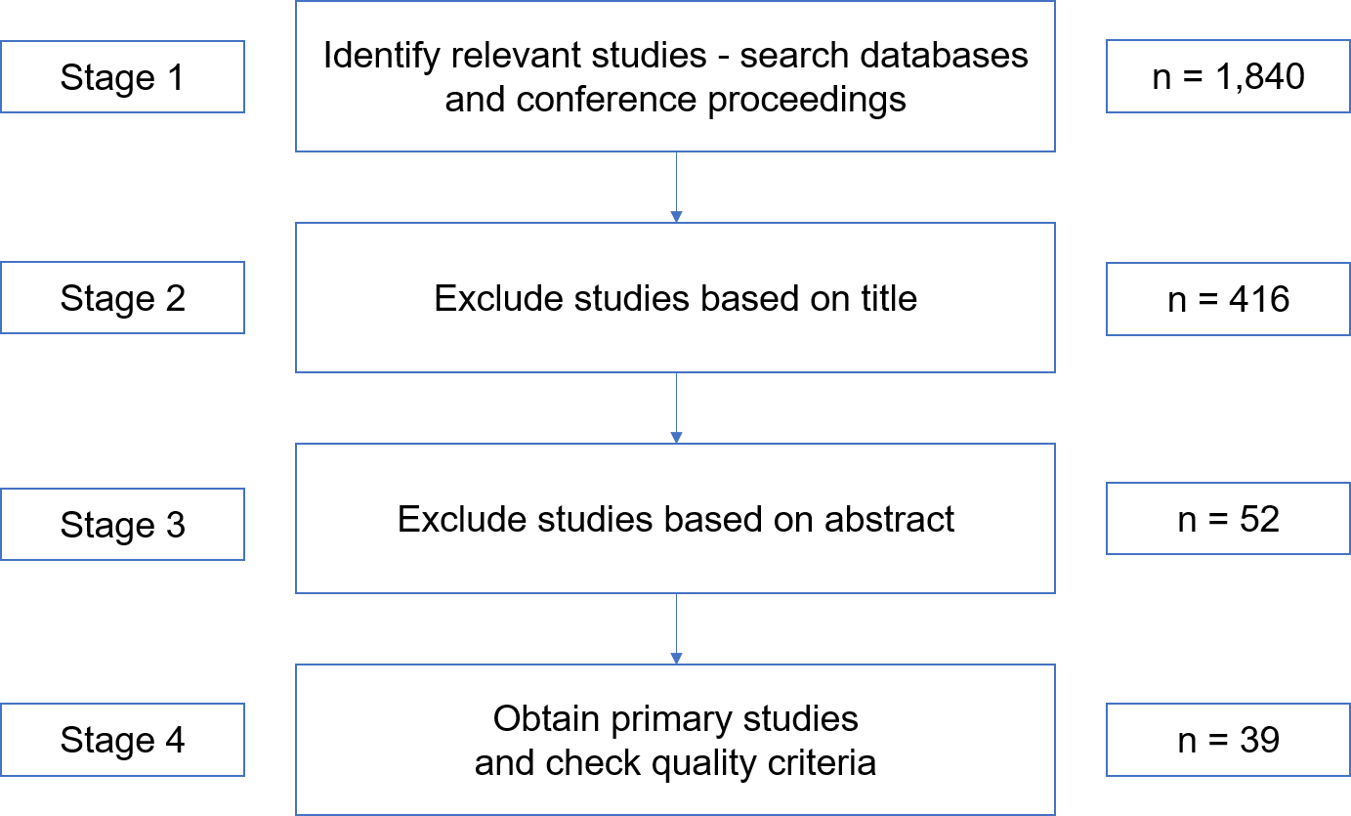
4. Empirical Research
Systematic Literature Review

Slide 32
4. Empirical Research
Systematic Literature Review
Sources:
  Databases
  ACM Digital Library
  Science Direct
  IEEE Xplore
  Conferences
  European Conference on Software Architecture (ECSA)
  International Conference on Software Architecture (ICSA)
  Working IEEE/IFIP Conference on Software Architecture (WICSA)
  International Conference on Design Science Research in Information Systems and Technology
Query:
  Search on title, keywords and abstract
  (“software architecture” OR “software design”) AND (role OR expert* OR “decision making”)
1.840 results

Slide 33
4. Empirical Research
Systematic Literature Review
Inclusion Criteria:
  Any study that quantifies expertise in the context of software development & design
  Any study that inspects roles in the context of software development & design
Exclusion Criteria:
  Any study that does not focus on the development or the process of development of software systems
  Any study that inspected student behavior
  Any study that is not a primary study
  Any study that does not pass the quality criteria
Study Selection Procedures:
  Identify relevant studies from databases and journals
  Exclude studies based on titles
  Exclude studies based on reading the abstract
  Obtain papers
  Final selection based on quality criteria

Slide 34
4. Empirical Research
Case Study
Interviews with architects and developers from industry to examine common practice problems
Example Questions:
Is there a standardized process to assign people to issues or tasks? If not, how does it work?
Is there a difference in assigning architecture or design problems?
Exist problems that are either solved by architects or developers?
Which parameters or factors inﬂuence the assignment of people to issues/tasks?
Exist common problems or challenges for the assignment of people to tasks or issues?

Slide 35
4. Empirical Research
Case Study
ID | Position | Professional Experience | Experience in current job | Responsibility | Domain
A1 | Software architect | 12 years | 3 years | Design system architecture | Transportation
A2 | Product owner | 10 years | 4 years | Define software system | Transportation
B1 | Senior consultant data management | 28 years | 3 years | Agile projects consultant | Various, project-based
B2 | Software architect | 3 years | ½ year | Design system architecture | Knowledge management
C1 | Software architect | 10 years | 1 ½ years | Develop & design system architecture | Project management

Slide 36
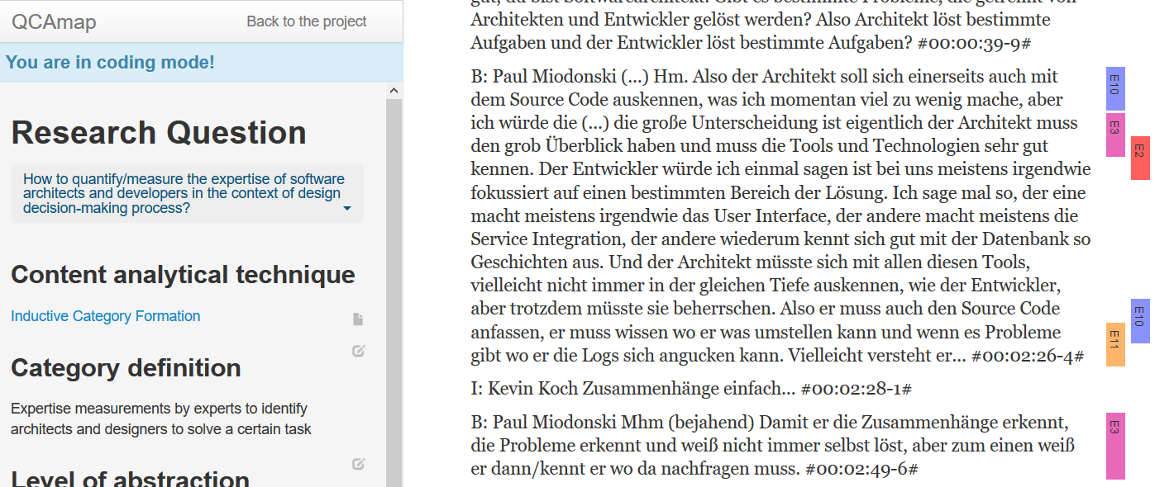
4. Empirical Research
Case Study
https://www.qcamap.org

Slide 37
4. Empirical Research
Meta-analysis for Requirements
Secondary Requirements
R11 | The system supports improving design decision’s description
R12 | The system provides visualization tools for describing design decisions
R13 | The system possesses workflow support for a design decision’s life cycle
R14 | The system shows related issues for a design decision
R15 | The system links relevant documentation for an issue
R16 | The system proposes possible technical concepts to solve a design decision
R17 | The system remembers experts about possible biases

Slide 38
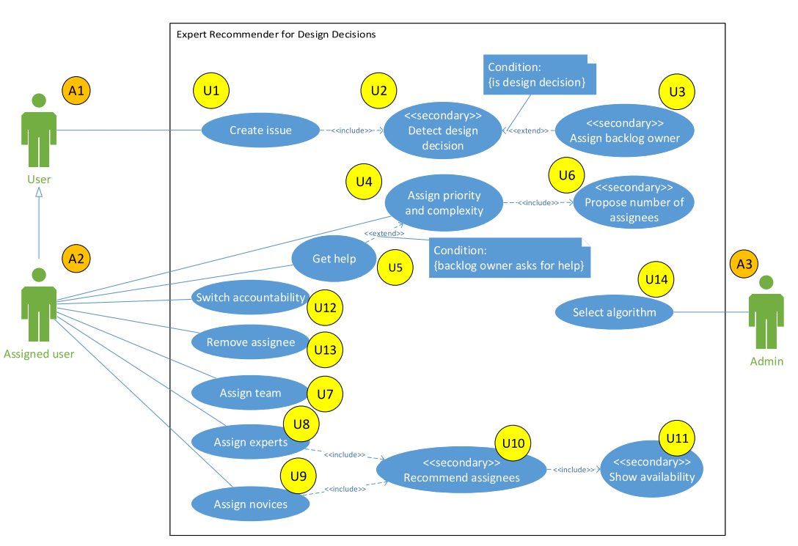
5. Prototype
Use Cases from Requirements
Notes:
To make it feasible in a system, translated requirements into use cases
It is obvious – expert recommendation takes best place in an issue management system… all requirements extend the functionality of common known issue management systems as JIRA or Github…
Three main actors whereas actually one has the main responsibility
User, assigned user, admin
-> let’s have a look for each user

Slide 39
5. Prototype
Use Cases from Requirements
Notes:
Normal user can only create new issues… the system then detects if it is a design decision… if yes the actual expert recommender starts
Then it assigns the backlog owner

Slide 40
5. Prototype
Use Cases from Requirements
Notes:
Next, the assigned user comes into place…
The initial assigned user is the backlog owner, but every assigned user can do the same
- Assign priority – if help is needed, can ask for help, if done the system proposes the number of assigness
Can hand over accountability, however mandatory that one user is
Can remove assignes
After the assessment of priority and complexity, three use cases are accessible
The first is assign team – includes as well to create a team
Assign experts and novices – the system recommends for the issue experts and novices…
Finally admin, can just select the algorithm that will we have look into in a second

Slide 41
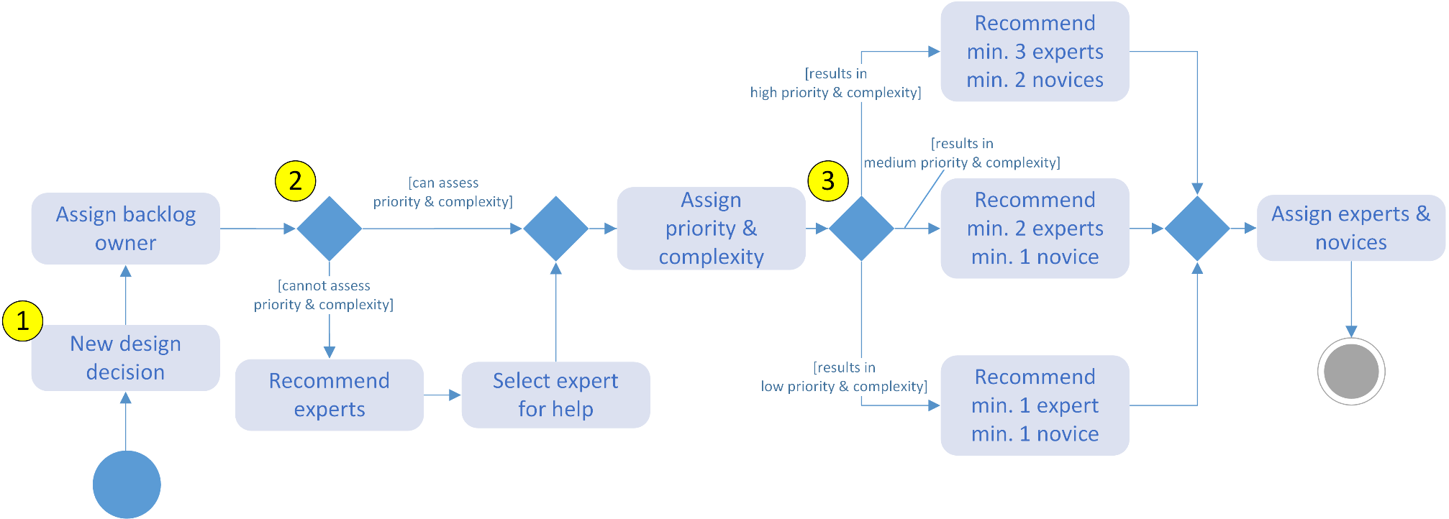
5. Prototype
Activity Diagram
Notes:
Use cases in time…

Slide 42
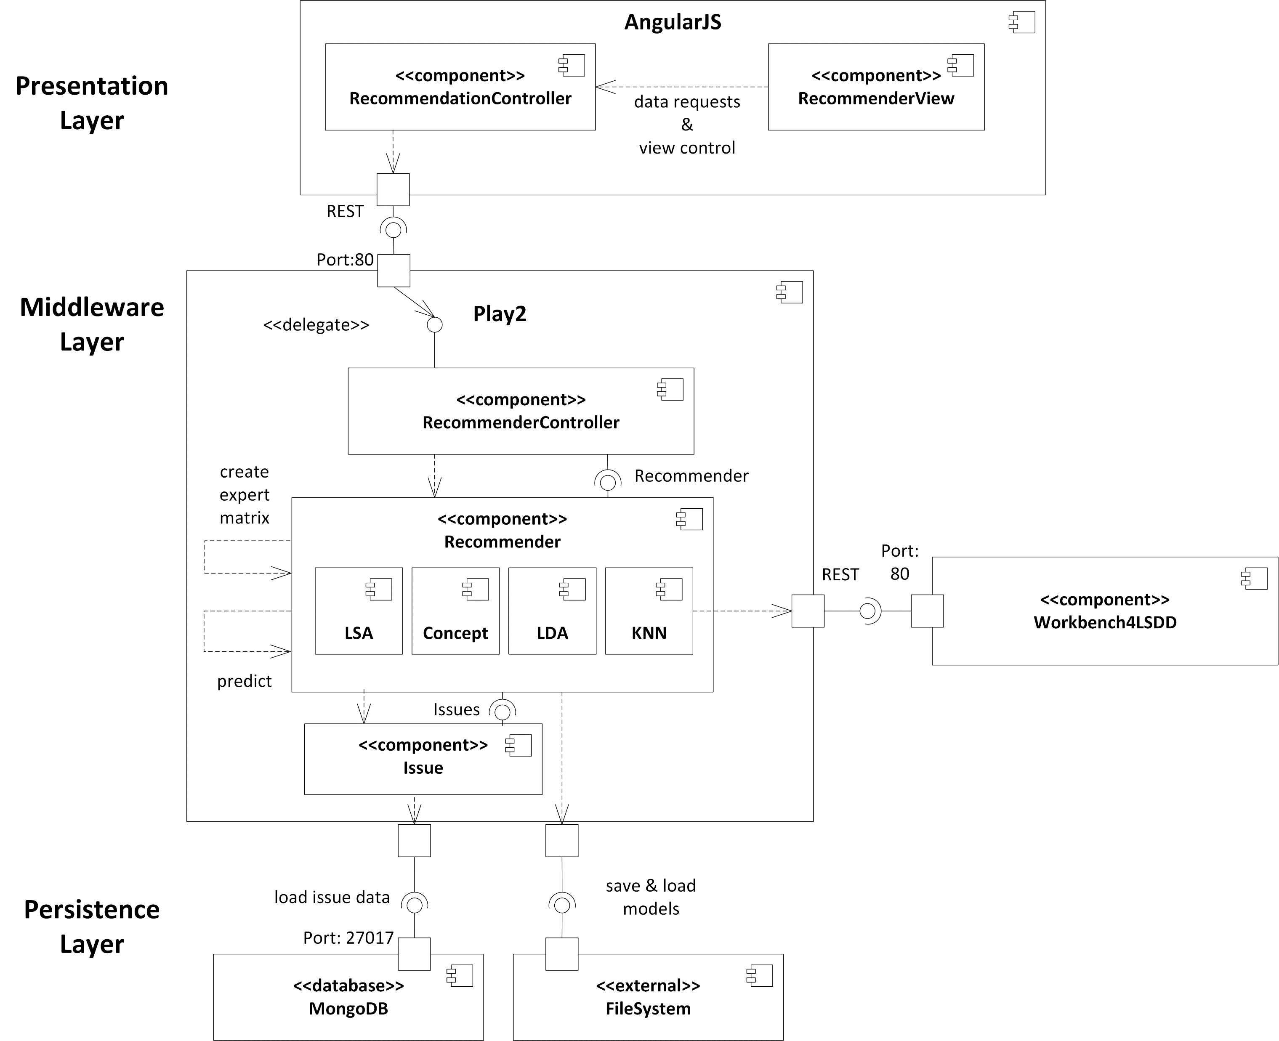
5. Prototype
Component Diagram
Notes:
After the requirements were translated into use cases and the system that needs to be built is a bit clearer… actual design of the system
With a component diagram
3 Layer architecture – Presentation, Middleware and Persistence Layer
Presentation Layer Developed with Angular and MaterializeCSS
Middlewarelayer = Play 2 Framework
Persistance = MongoDB

Slide 43
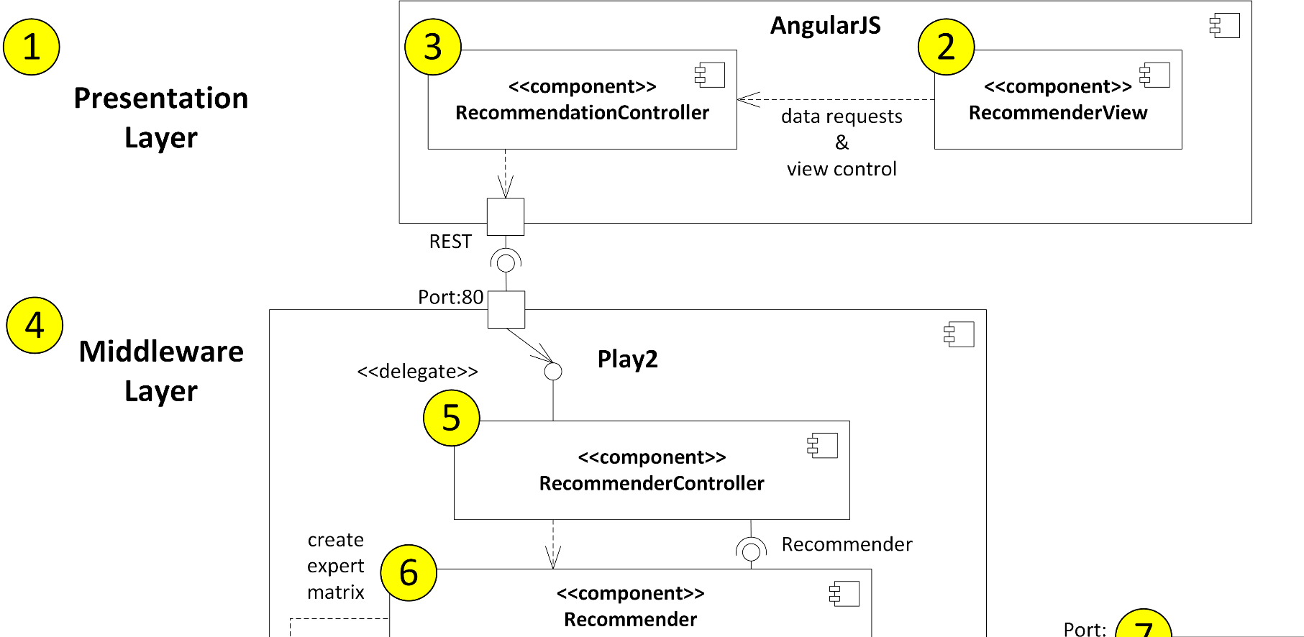

5. Prototype
Component Diagram
Notes:
Presentation Layer – a View with controller that manages the presentations layer state and handles REST http request to the middleware layer
Middleware Layer – RecommenderController receives the presentation layer’s request, from there on, the recommendation requests are further processed

Slide 44
5. Prototype
Component Diagram
Notes:
Middleware Layer: previous slide seen recommenderController… which instantites a Recommender object and a specific algorithm
AbstractFabric pattern used – Factory class institaties an abstract recommender with a defined interface as a concrete algorithm implementation
They share the same steps as previously explained, just their detail implementation changes
External library for KNN
And the system works with the issues from issue management systems

Slide 45
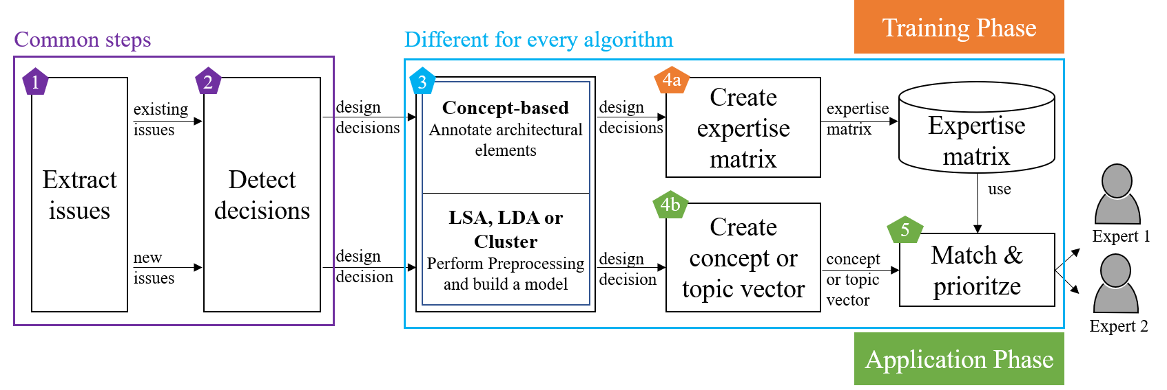
5. Prototype
Procedure of algorithms
Notes:
How do these algorithms work? They have a common shared procedure…
Two different phases – a training phase and a application phase
in the training phase, all issues that are labeled as design decisions are analayzed by the system. Either the architectural elements or the preprocessing steps and model building of the other methods
Then, for each assignee its skill in either the concepts, topics or clusters is in an expertise matrix summarized
the matrix is stored
In the application phase, similar previous steps however just for single design decision… then extract features and match with expertise matrix… to identify experts

Slide 46
5. Prototype
Algorithm settings and steps
Concept | LSA | LDA | Cluster
Tokenize Lowercase Remove stop words | Tokenize Lowercase Remove stop words Up to 2-ngrams tf-idf, keep 1.000 terms | Tokenize Lowercase Remove stop words Up to 2-ngrams Create term-document matrix | Tokenize Lowercase Remove stop words
Frequency count of architectural elements | Singular Value Decomposition | Gibbs-sampling | Word2Vec
 |  |  | k-nearest neighbor
Build the sum of frequencies for each developer | Calculate for each developer her/his strength in topics | Calculate for each developer her/his strength in topics | Count for each developer solved issues per cluster

Slide 47
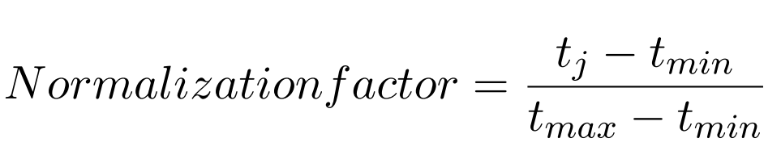
5. Prototype
Concept-based & decreasing knowledge
Concept-based [4]
Extension: Decreasing knowledge
Project lifetime
Start
Issue j
Today
tmax
tj
tmin
Frequency count of technical skill per developer
Frequency count normalized by date of issue

Slide 48
5. Prototype
Latent Semantic Analysis [5]
U
Σ
V^{T}
tf-idf matrix
 | T1 | T2 | T3 | …
D1 | 2.4 | 14.6 | 22.1
D2 | 12.1 | 0.5 | 13.2
D3 | 6.3 | 8.7 | 4.2
…
Document-to-topic
matrix
Topic strength
matrix
Term-to-topic matrix
=
n x n
n x m
m x m
m x n

Slide 49
5. Prototype
Latent Dirichlet Allocation [6]
Topic 1
java 0.04
lambda 0.02
…
Fix the java8-tests profile and run those tests in Jenkins
Spark has some tests for compilation of Java 8 sources (using lambdas) guarded behind a {{java8-tests}} maven profile, but we currently do not build or run those tests. As a result, the tests no longer compile. We should fix these tests and set up automated CI so that they don't break again.
Topic 2
test 0.05
run 0.02
…
Topic 3
compile 0.05
automated CI 0.02
…

Slide 50
5. Prototype
Word2Vec [7]
Word vector for all words
Hidden Layer Neurons
Output Layer
0
0
1
0
0
0
0
0
0.11
0.09
0.01
0.12
0.16
0.03
0.12
0.22
test
…
∑
∑
∑
∑
∑
∑
∑
Position of word java
java
…
SDK
…
…
…
e.g. 10.000
words in corpus
Similarity of each word to input word
e.g. 1.000

Slide 51
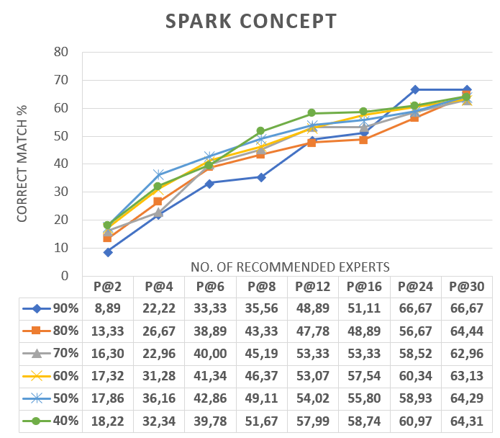
6. Evaluation
Apache Spark Project

Slide 52
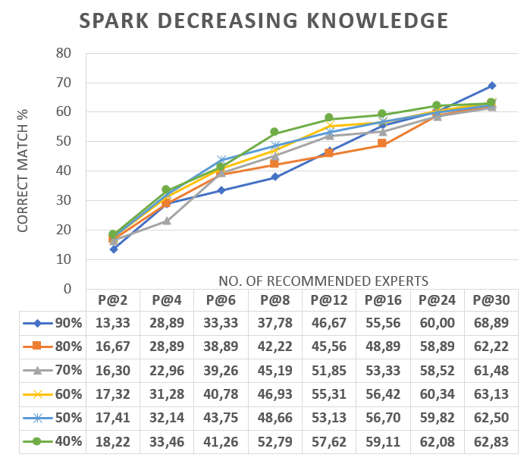
6. Evaluation
Apache Spark Project

Slide 53
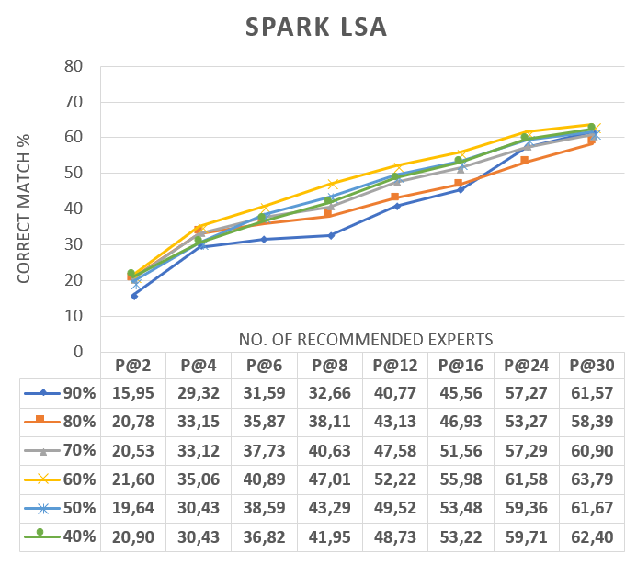
6. Evaluation
Apache Spark Project
Average results for k from 2 to 200

Slide 54
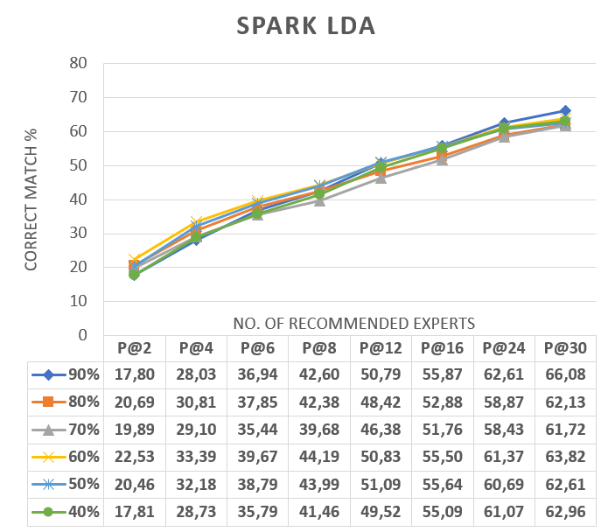
6. Evaluation
Apache Spark Project
Average results for k from 2 to 200

Slide 55
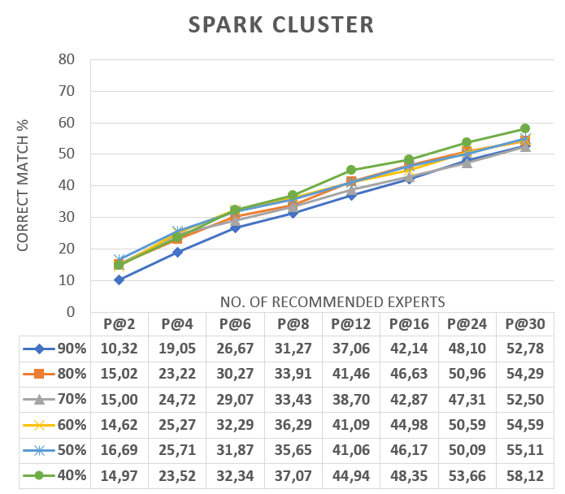
6. Evaluation
Apache Spark Project
Average results for k from 2 to 30

Slide 56
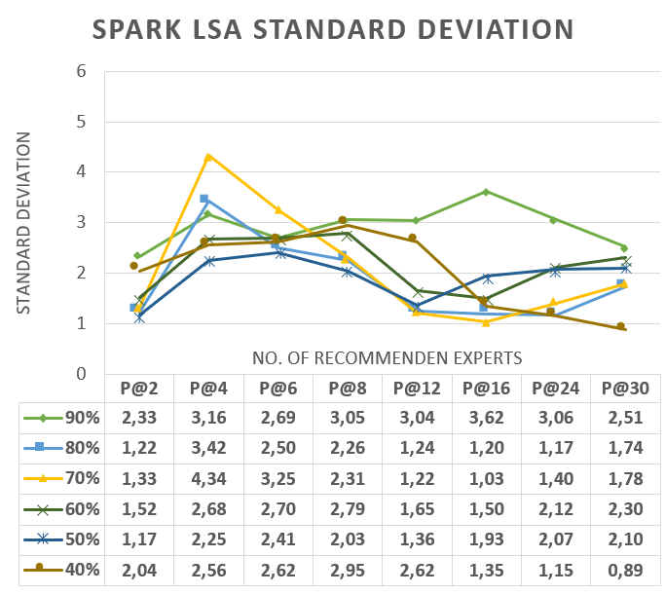
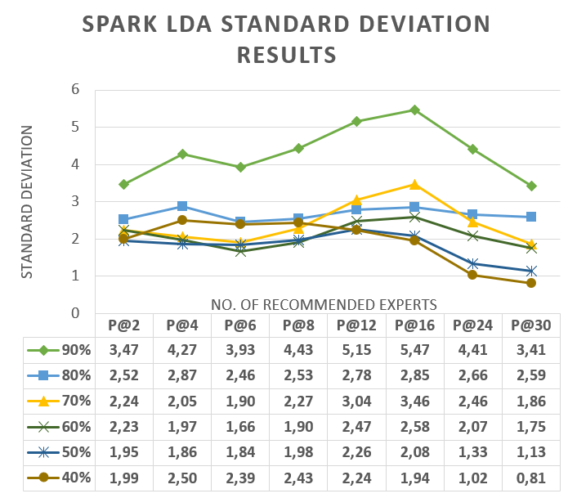
6. Evaluation
Apache Spark Project

Slide 57
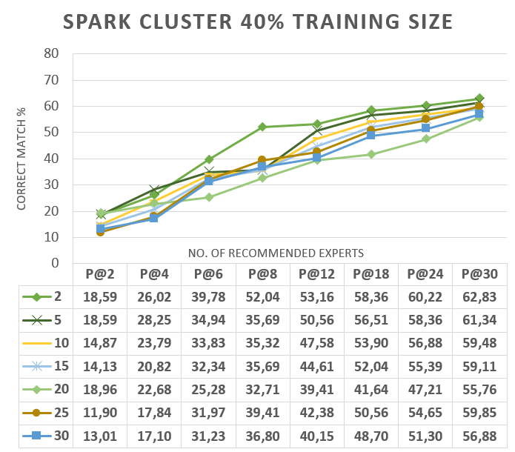
6. Evaluation
Apache Spark Project
k

Slide 58
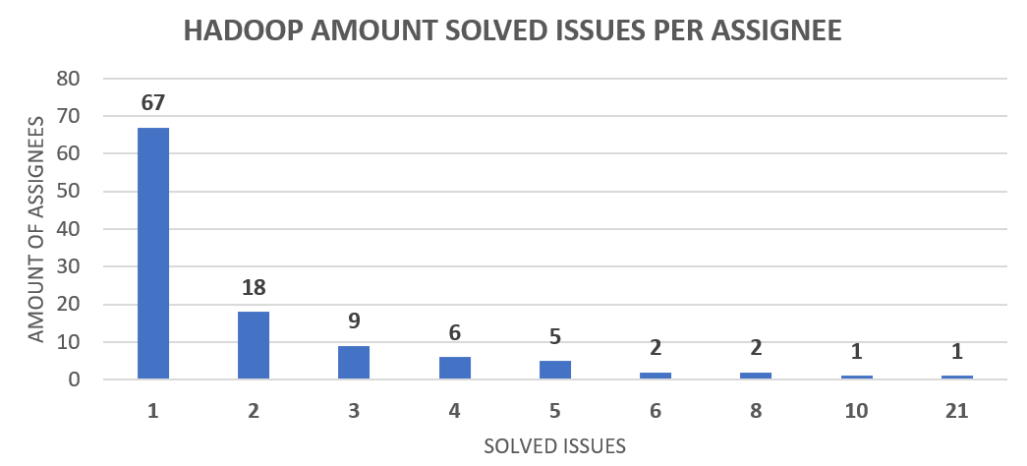
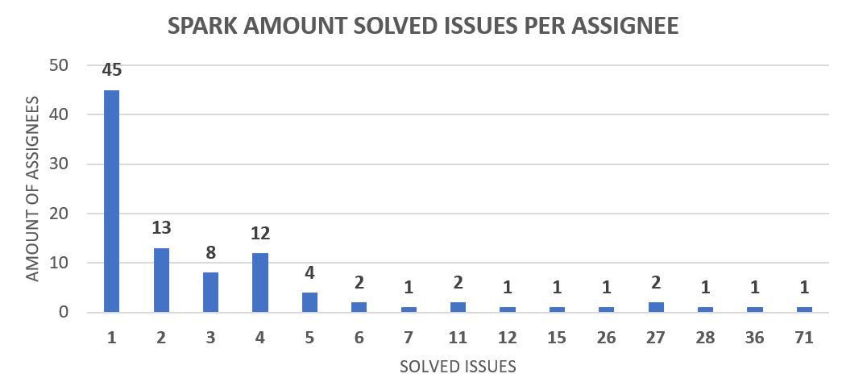
6. Evaluation
Apache Hadoop Project
On average only 2.1 design decisions per assignee, fewer design decisions and distribution over a long time span
Notes:
4.7 in spark

Slide 59
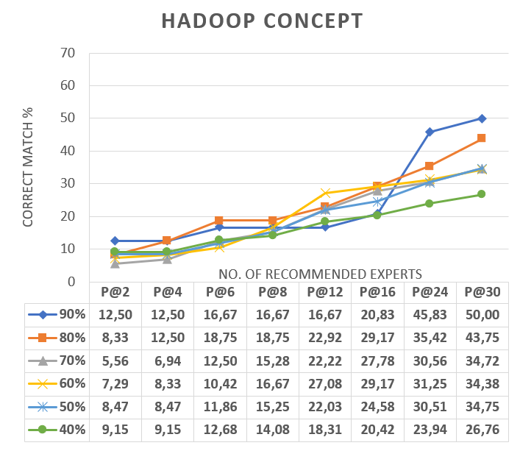
6. Evaluation
Apache Hadoop Project

Slide 60
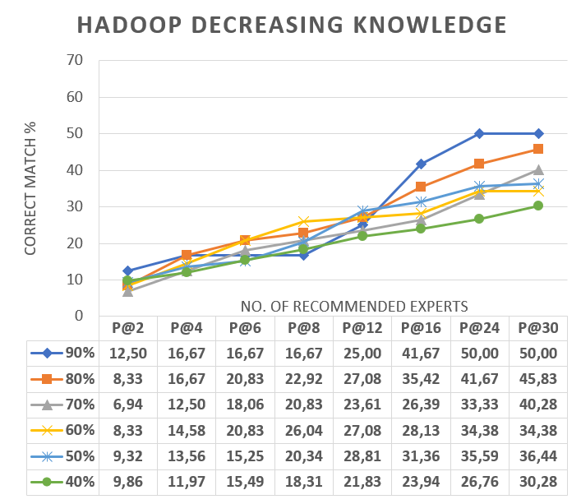
6. Evaluation
Apache Hadoop Project

Slide 61
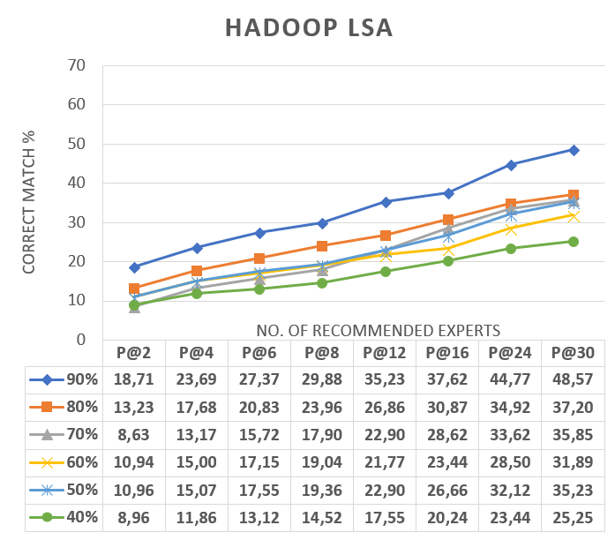
6. Evaluation
Apache Hadoop Project
Average results for k from 2 to 200

Slide 62
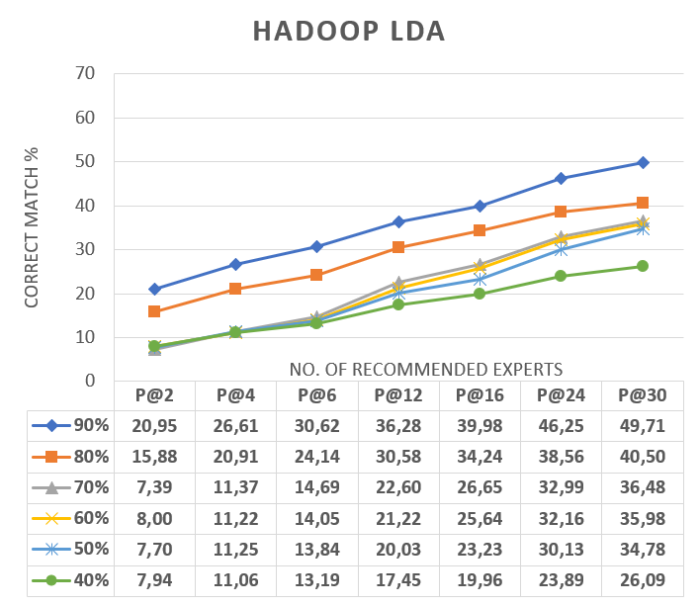
6. Evaluation
Apache Hadoop Project
Average results for k from 2 to 200

Slide 63
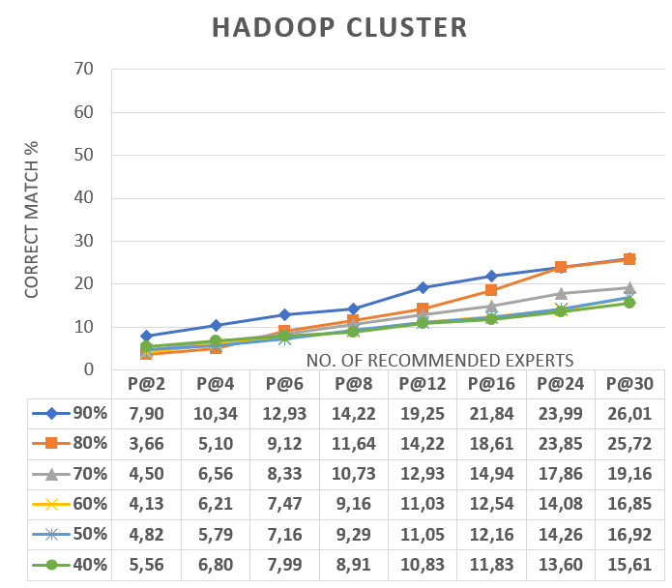
6. Evaluation
Apache Hadoop Project
Average results for k from 2 to 30

Slide 64
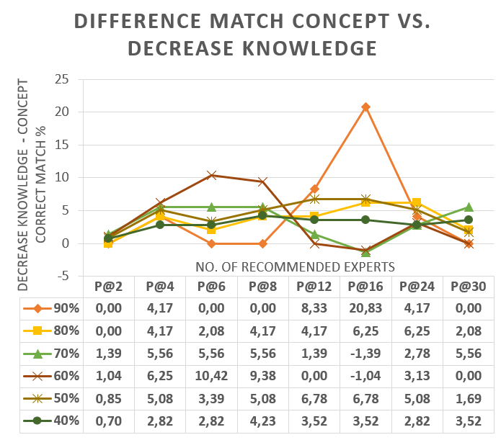
6. Evaluation
Apache Hadoop Project

Slide 65
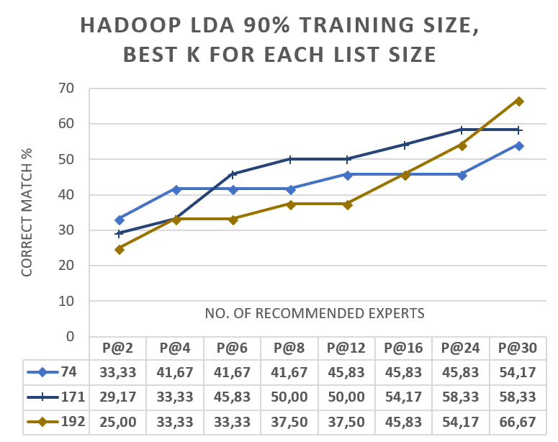
6. Evaluation
Apache Hadoop Project

Slide 66
Timeline
2017
2018
Tasks
  Month
11
12
1
2
3
4
5
Kick-off Presentation
Systematic Literature Review
Case Study
Development
Evaluation
Writing
Final Presentation

